Slide 1

Lingayas Institute of Management and Technology
Approved by AICTE, Affiliated to JNTU Kakinada, Accredited with A Grade by NAAC and
UG-CSE is accredited by NBA
Mean Stack Web Technologies Mini Project
SMART CITY RESCUE
Team Members:
23NA1A5424- Geethika.A
23NA1A5430- Mounica.P Under the Guidance of
Prof.Pavan Akhil
Department of
Artificial Intelligence and Data Science

Slide 2
Contents
Introduction
Problem Statement
Objectives of the Present Study
Literature Review [Purpose of the Study]
Materials and Methods / Methodology
Software & Hardware Requirements
System Design
Implementation & Testing and Validation / Result and Discussion
Conclusion And Scope for Future Work
Acknowledgement
References
Thank You

Slide 3
INTRODUCTION
Smart City Rescue is an interactive game-based application designed to create awareness about common problems in urban areas.
In this game, players act as Smart City Rescue Officers and complete different missions such as garbage collection, street light repair, water leakage control, road repair, and traffic management.
The application makes learning more interesting through missions, rewards, points, levels, and achievements.
The main aim of this project is to educate users about smart cities and encourage them to solve real-world city problems through an enjoyable gaming experience.

Slide 4
Problem Statement
Urban areas face many common problems such as improper garbage disposal, water leakage, damaged roads, traffic congestion, and insufficient public awareness.
Traditional awareness methods like posters, notices, and text-based information may not always attract people's attention or encourage active participation.
Therefore, we need an interactive system that helps people understand urban problems in an interesting way.
Smart City Rescue solves this problem by converting common city challenges into interactive game missions.

Slide 5
Literature Review
Paper / Project / Source | Method Used | Key Finding | Reference / Publisher
Smart City Applications | Digital Technologies | Technology helps improve waste management, traffic and public safety. | Research Studies
Game-Based Learning | Interactive Games | Games make learning more interesting and improve problem-solving skills. | Educational Research
Smart City Awareness Systems | Websites & Mobile Applications | Users can learn about urban problems through digital platforms. | Existing Applications
Interactive Mission-Based Systems | Gamification & Rewards | Missions, points and rewards encourage user participation. | Project Study

Slide 6
Research Gap & Project Improvement
Existing Limitation / Gap | How our Project Improves | Related Reference
Existing systems mainly provide information about city problems. | Our app converts city problems into interactive rescue missions. | Section 2.4
Traditional learning methods have limited user interaction. | Our project uses game-based learning with challenges and mini-games. | Section 2.3
Existing approaches provide less motivation for continuous participation. | Our app provides coins, XP, stars and rewards to encourage users. | Section 2.5
Some systems have limited visualization of city improvement. | Our app provides an interactive city map and progress tracking. | Section 2.2
Existing methods have less focus on problem-solving activities. | Our roject provides missions like garbage collection, road repair and water leakage control. | Section 3.6

Slide 7
Project Work Timeline(Trello Board)
Trello List | Tasks to Show | Owner | Status | Evidence
To Do | AI-Based Mission Recommendations | Team Member | Planned | Planned Tasks
In Progress | UI Design, City Map & Mission Module | Team Member | Ongoing | UI Screenshots
Testing | Login, Mission & Reward Testing | Team Member | Testing | Test Results
Completed | Project Planning, Literature Review, Requirement Analysis, Database Design | Team Member | Done | Documents & Screenshots
Blocked / Issues | AI Integration & Advanced Features | Team Member | Needs Support | Issue Notes

Slide 8
Purpose and objectives of the present study
Purpose of the Present Study:
To create awareness about smart city development.
To identify common urban problems.
To encourage users to solve city problems through missions.
To improve problem-solving and decision making skills.
To promote smart city awareness through interactive gaming.
Objectives of the Present Study:
To create awareness about smart city problems.
To develop interactive rescue missions.
To improve problem-solving skills.
To provide rewards and achievements.
To track player progress.
To make learning enjoyable through gaming.

Slide 9
Materials and Methods Methodology
(Tools, Dataset, Hardware & Software Requirements)
Materials and Methods
Materials:
Computer/Laptop
Internet Connection
Base44 Platform
Application Interface and Data Services
Game Assets and web Browser
Methods:
Requirement Analysis
System Design,Testing
Application Development
Module Development
Game Implementation
Progress Tracking

Slide 10
Materials and Methods Methodology
(Tools, Dataset, Hardware & Software Requirements) Cont…
Methodology:
Requirement Collection.
Planning and Design.
Development.
Module Integration.
Testing and Evaluation
Tools Used:
Base44
HTML, CSS, Javascript
Database/ Backend Services
Web Browser
AI/ML Concepts

Slide 11
Materials and Methods Methodology
(Tools, Dataset, Hardware & Software Requirements) Cont…
Dataset:
Smart City Problem Data
Garbage Management Data
Water Leakage Data
Road Damage Data
Traffic Management Data
Street Light Data

Slide 12
Materials and Methods Methodology
(Tools, Dataset, Hardware & Software Requirements) Cont…
Hardware Requirements:
Laptop or Desktop
Processor
4 GB RAM with the storage of 500GB HDD or SSD
Internet Connection
Display
Software Requirements:
Windows 10
Base44 Platform
HTML, CSS and Javascript
Database
Web Browser
Internet Connection

Slide 13
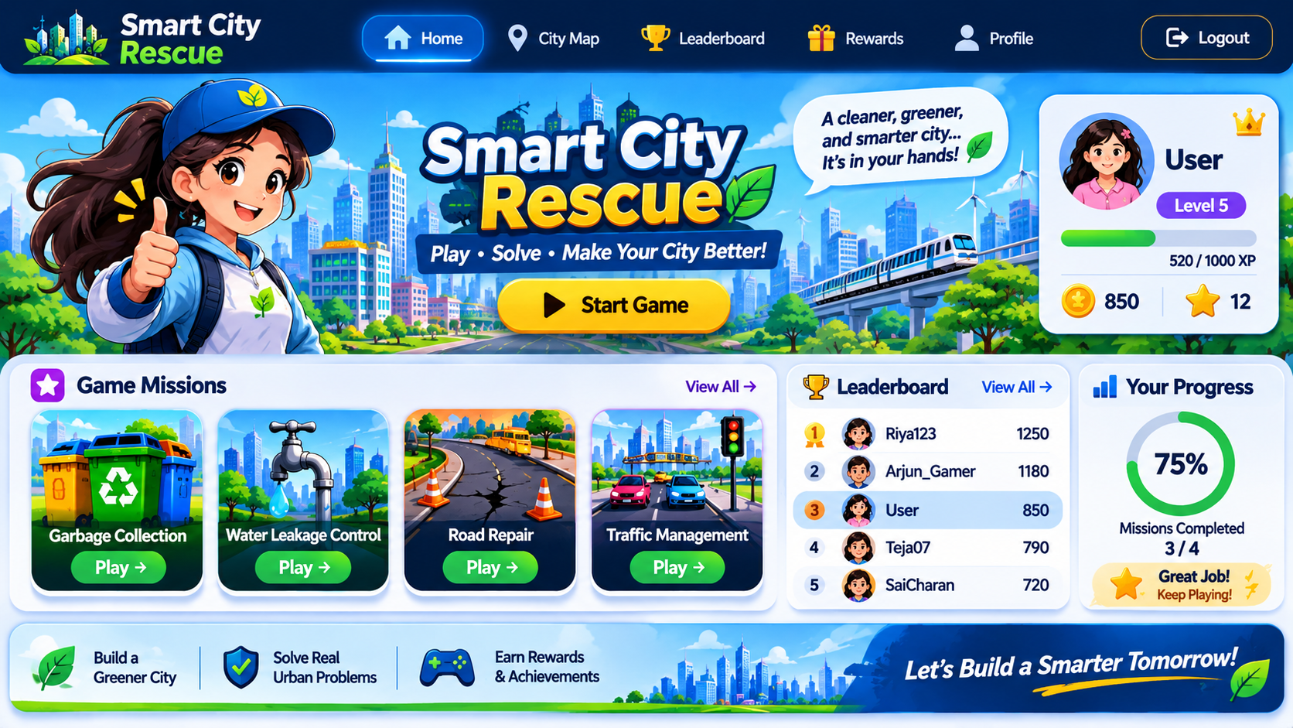
System Design
Provides simple and user-friendly interface.
Allows users to register and login.
Displays game options and player information.
Shows the virtual smart city and available missions.
Provides challenges like garbage collection, road repair and water leakage control.
Award points, coins, XP and achievements.
Leaderboard displays player rankings.
Tracks completed missions and player performance.

Slide 14
Results and Discussion
(Implementation Progress, Screenshots/Output, Testing/Validation, Current Issues and Fix Plan)
Results and Discussion:
Successfully developed the Smart City Rescue application using Base44.
Provided interactive missions.
Added points, coins, XP and achievements to motivate players.
Leaderboard is to display player rankings based on their scores.
Shows completed missions and player performance.
Login, citymap, mission, selection, rewards, profile and leaderboard features were tested successfully.
Implementation Progress:
Website design and user interface were completed successfully.
User registration, login, and complaint submission features were implemented.
Image upload, GPS location, and Firebase database were integrated.
Admin dashboard, complaint tracking, and notification system were developed and tested.

Slide 15
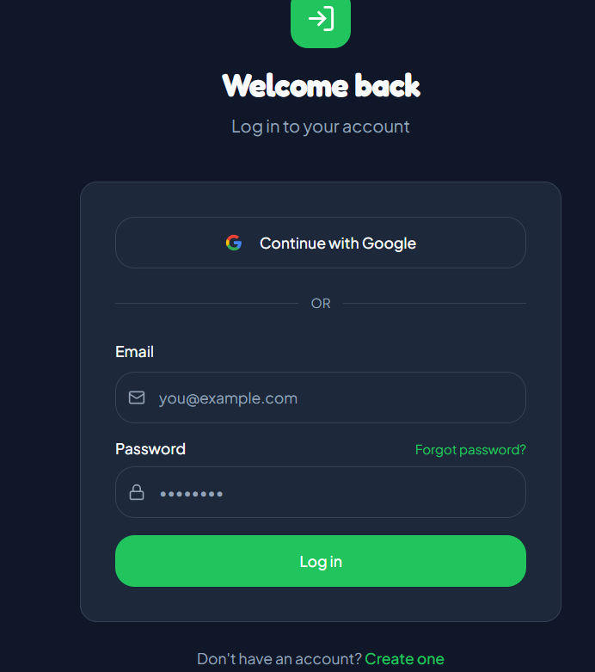
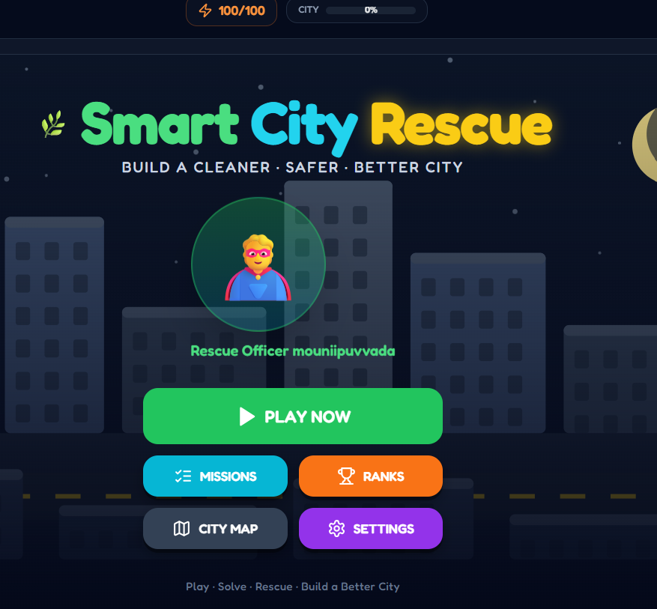
Results and Discussion
(Implementation Progress, Screenshots/Output, Testing/Validation, Current Issues and Fix Plan) Cont….
Screenshots &Outputs:

Slide 16
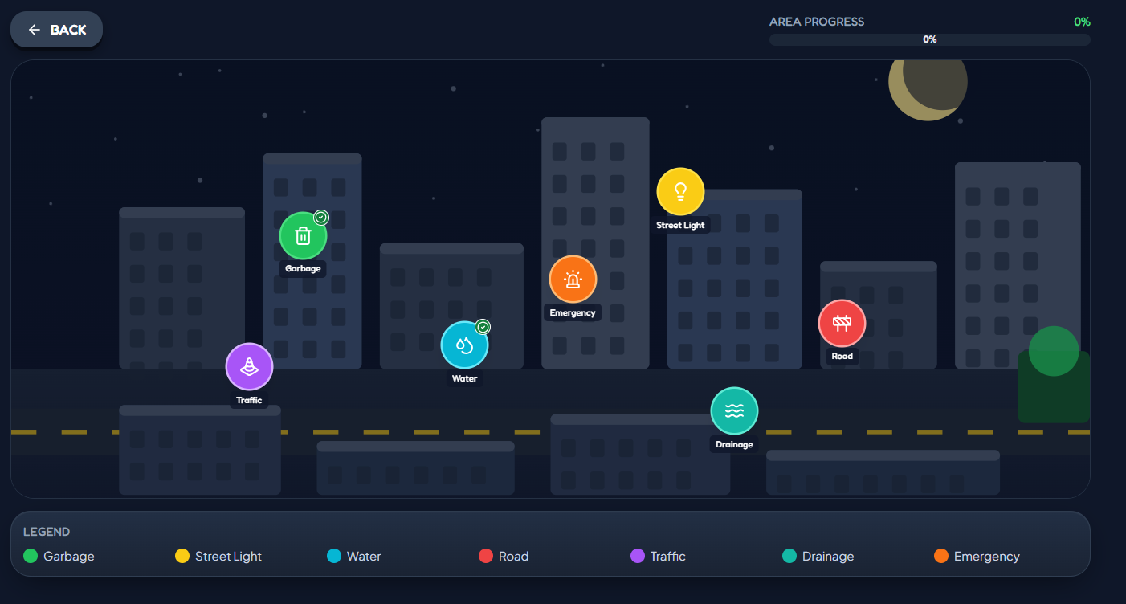
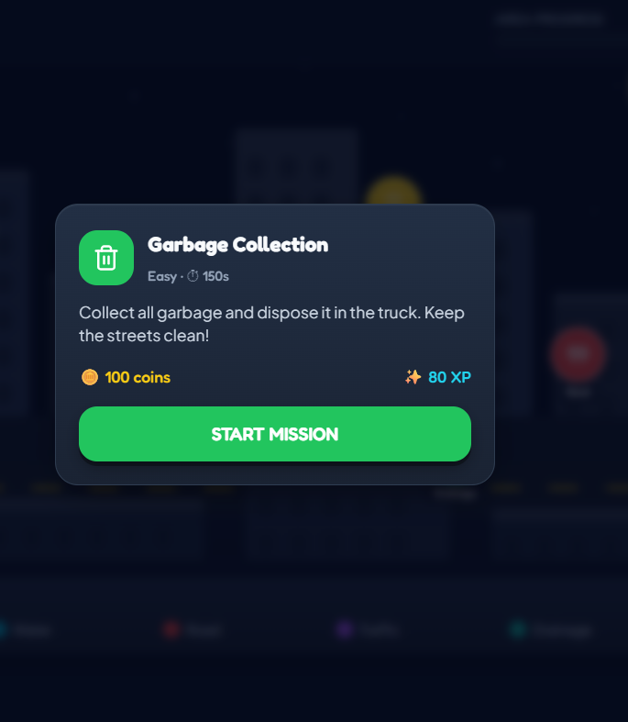
Results and Discussion
(Implementation Progress, Screenshots/Output, Testing/Validation, Current Issues and Fix Plan) Cont….
Screenshots &Outputs:

Slide 17
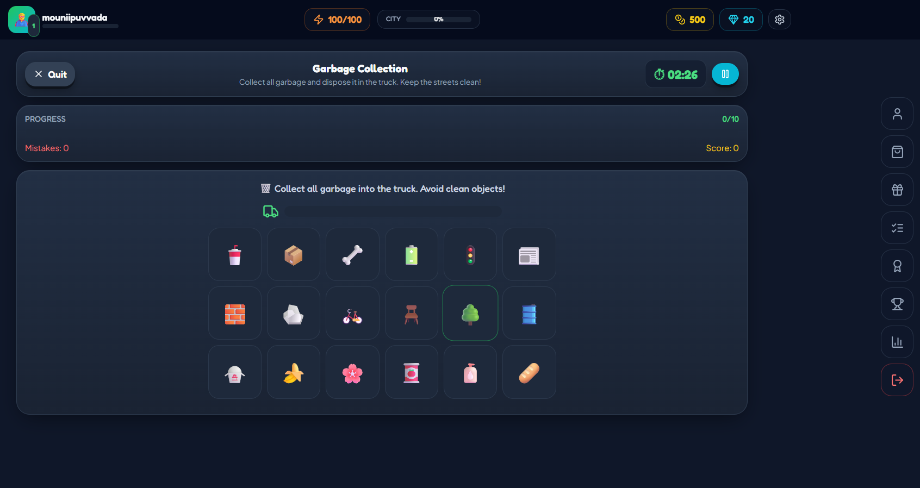
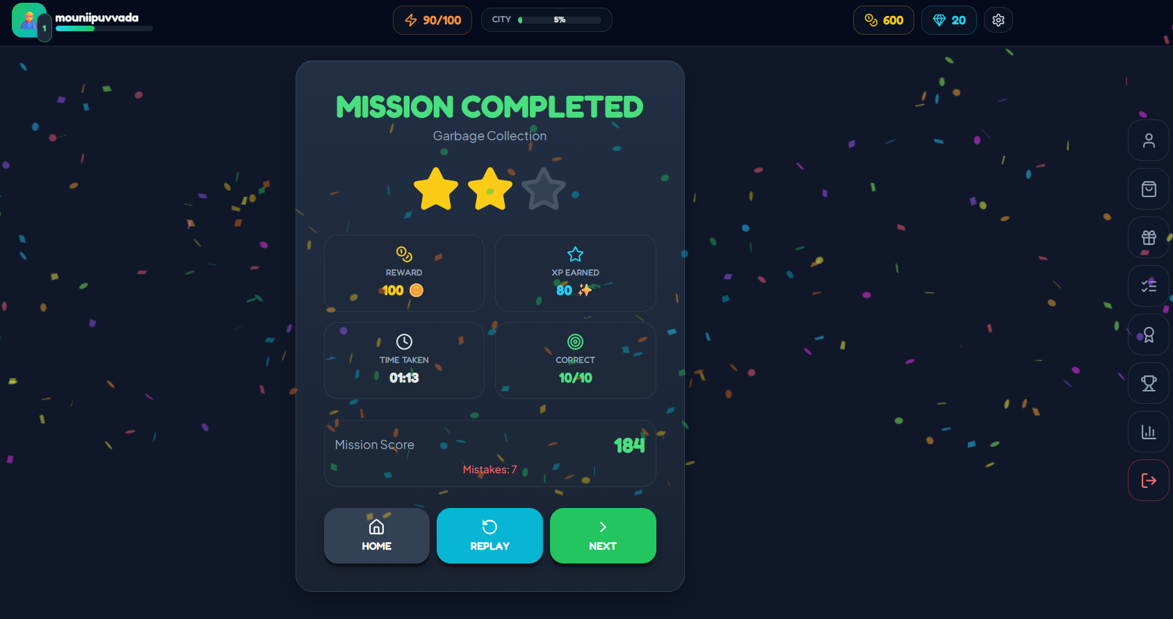
Screenshots &Outputs:

Slide 18
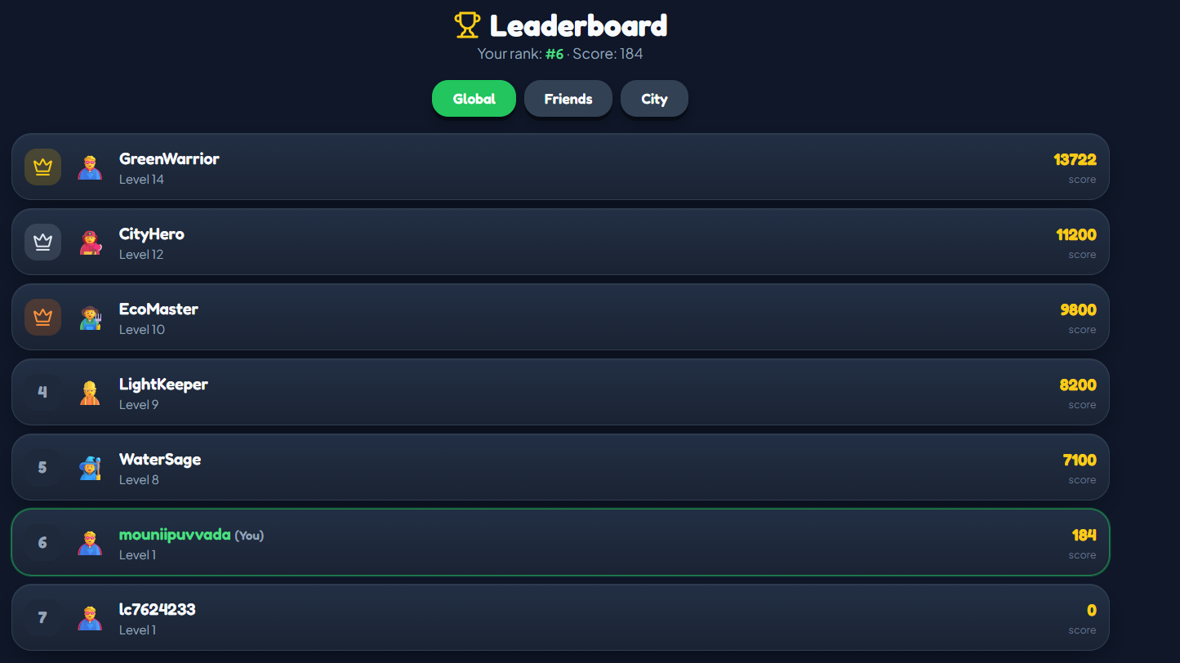
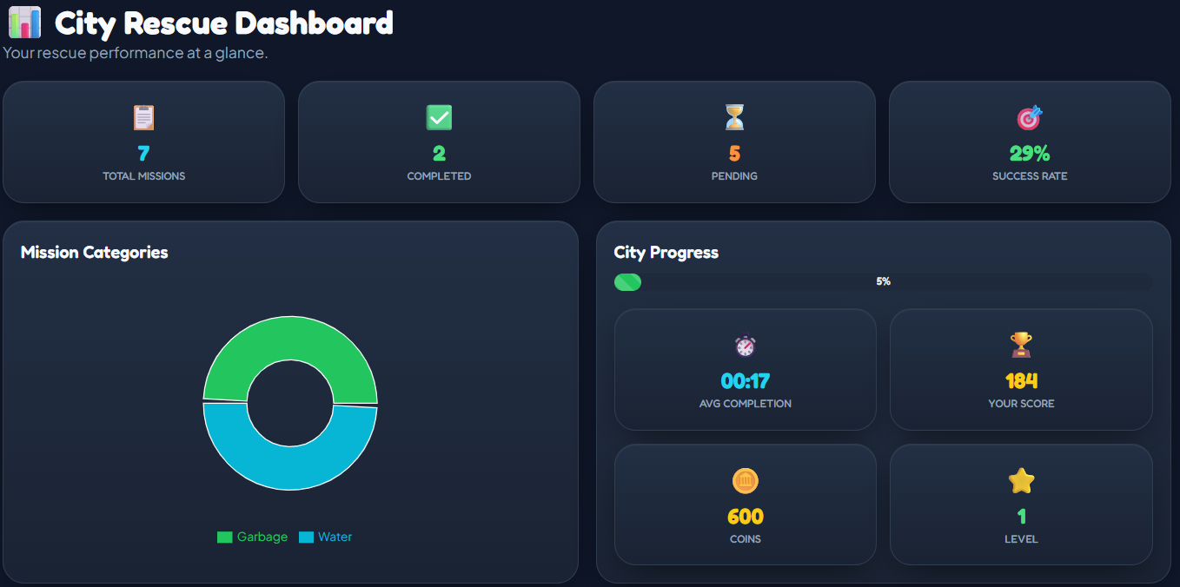
Screenshots &Outputs:

Slide 19
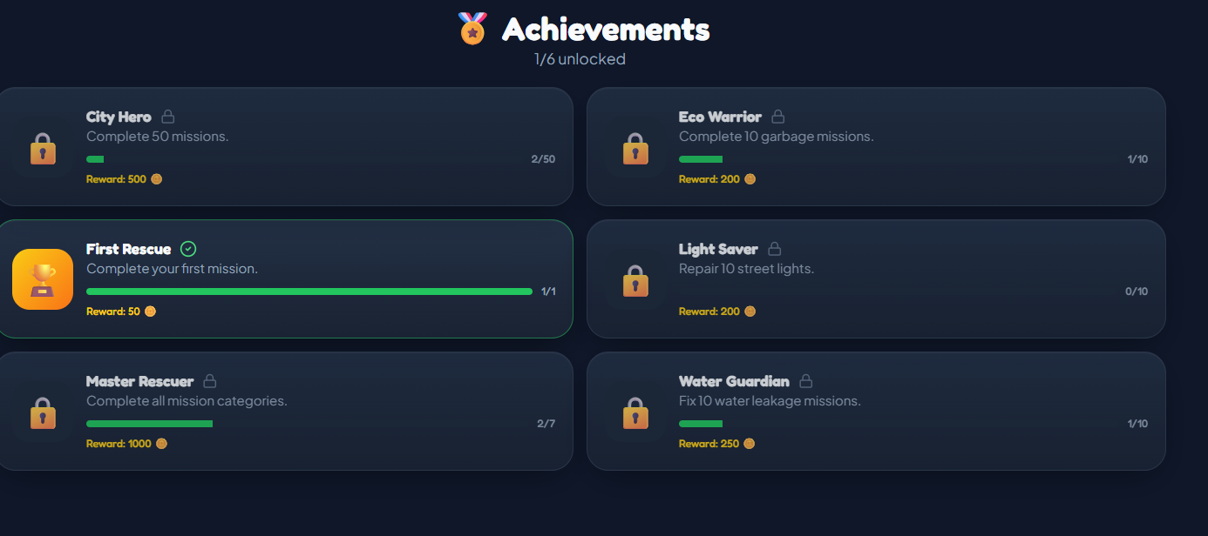
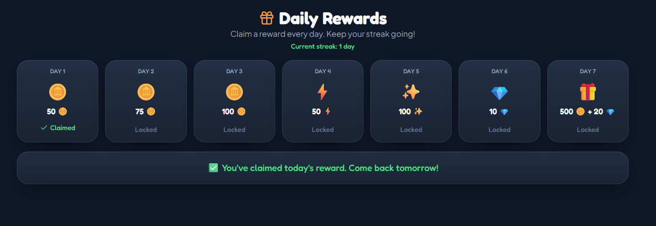
Screenshots &Outputs:

Slide 20
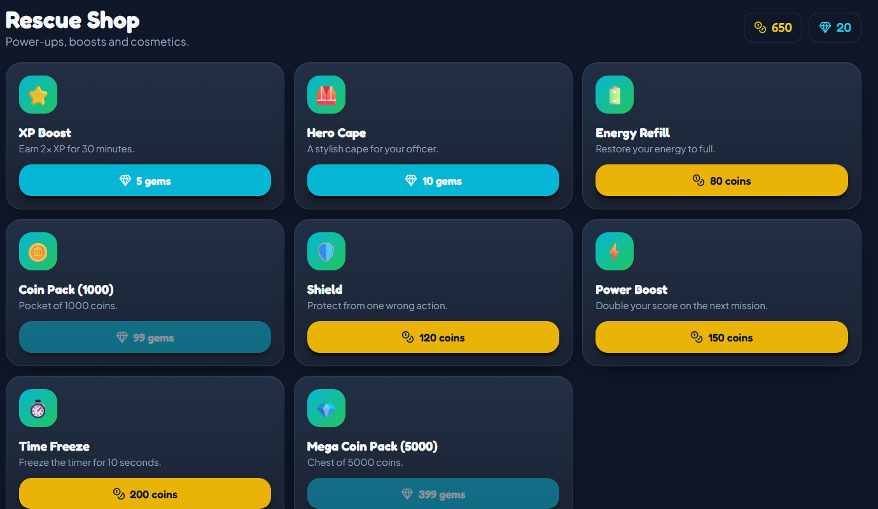
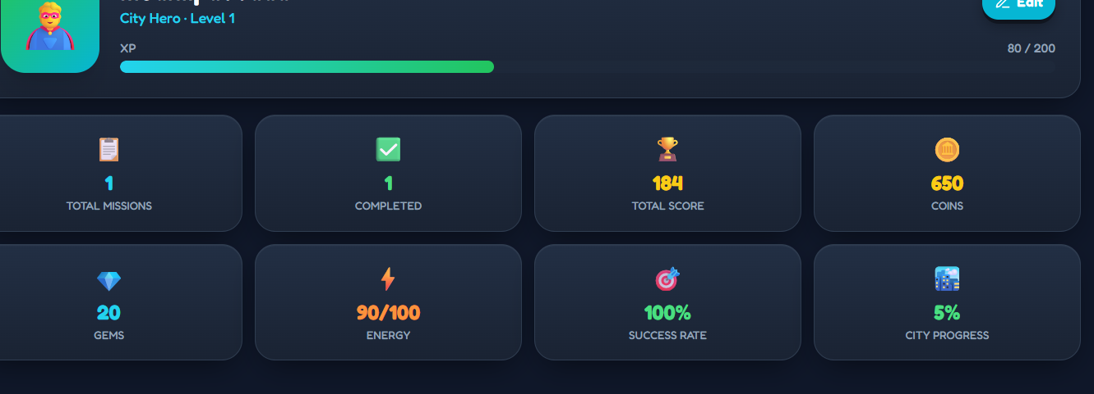
Screenshots &Outputs:

Slide 21
Results and Discussion
(Implementation Progress, Screenshots/Output, Testing/Validation, Current Issues and Fix Plan) Cont….
Testing & Validation:
Tested user registration and login functionally.
Verified that the city map opens correctly.
Checked mission selected and starting process.
Testing mission completion and reward generation.
Verified player profile details.
Checked leaderboard functionally.
Current Issues:
Limited real-time city information.
Lack of integration with real-world smart city services.
Fix Plan:
Add real-time city information updates.
Integrate smart city services for better connectivity.

Slide 22
Conclusion
Smart City Rescue provides an interactive way to learn about city problems.
It encourages problem-solving through missions and rewards.
It promotes smart city awareness through game-based learning.
The application makes learning simple, engaging and enjoyable.

Slide 23
Acknowledgements
We as a team would like to articulate my profound gratitude and indebtedness to my guide Assistant Professor/Associate Professor/ Professor, ______ sir, of _____ department, who has always been a constant motivation and guiding factor throughout the project period. It has been a great pleasure for me to get an opportunity to work under his guidance and complete the project successfully
We extend our gratitude to our Principal Dr___ sir, Lingaya’s Institute of Management & Technology for his encouragement and facilities provided during the course of project.
My sincere thanks to Prof. Swarup sir, Assistant Professor, department of ___________ engineering for his encouragement and technical support in completing the project work well in time.
We would like to articulate our beloved Chairman Mr. Rajling Gadde, Lingaya’s Institute of Management & Technology for his great motivation and encouragement towards the project work.
We are grateful to other staff members of _______ Engineering department for co-operating with us throughout our project.
We thank labs faculty of the ______ Engineering department for their support and helping us in all the labs
We thank all the previous faculty of our institute in helping us to gain knowledge in _______ engineering department
We thank the library facility available in LIMAT
We thank all our friends and batch mates' of B Tech 2021 batch who were with us during thick and thin of project time and were great support throughout the undergraduate period
In one way or another many people have contributed to the completion of this project work; It is difficult to acknowledge all of them. We have mention only some.

Slide 24
References
MongoDB Official Documentation. Available at:
https://www.mongodb.com/docs/
React.js Documentation. Available at:
https://react.dev/
Express.js Documentation. Available at:
https://expressjs.com
Node.js official Documentation. Available at:
https://nodejs.org/docs/
Website Link: https://smart-city-hero.base44.app

Slide 25
Thank You

